Slide 1
AIDFL: An Information Theory-Based Anomaly Detector in Decentralized Federated Learning
MSc Thesis – Final Presentation
Xiao Chen
21-742-820
Supervisors:
Chao Feng, Dr. Alberto Huertas Celdran

Slide 2
Table of Contents
01
Introduction
02
Motivation
03
Design
04
Evaluation
05
Conclusion

Slide 3
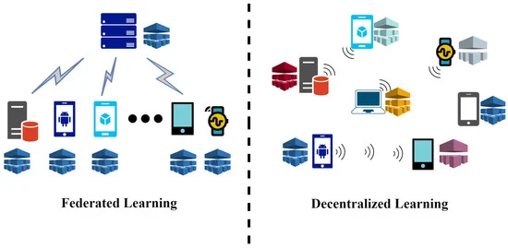
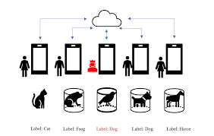
Federated Learning (FL)
Central server
Federated Learning (FL):
Local training on edge devices
Decentralized FL:
Without central server
Solution to data heterogeneity
Poisoning Attacks:
Surface: Data & Model
Objective: Untargeted & Targeted (Backdoor)

Slide 4
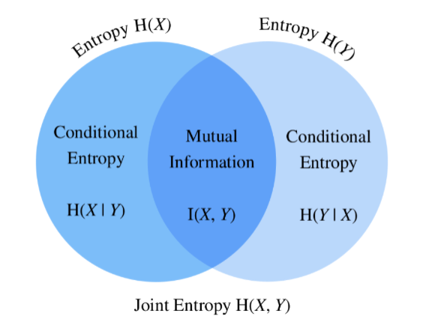
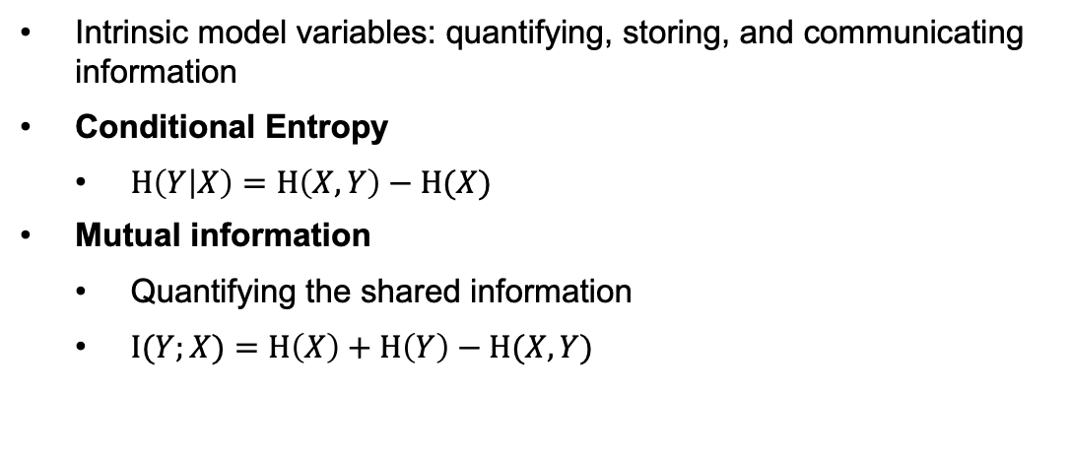
Information Theory
Intrinsic model variables: quantifying, storing, and communicating information
Conditional Entropy
$H\left(Y | X\right)=H\left(X,Y\right)−H(X)$
Mutual information
Quantifying the shared information
$I(Y;X)=H\left(X\right)+H\left(Y\right)−H(X,Y)$

Slide 5
Table of Contents
01
Introduction
02
Motivation
03
Design
04
Evaluation
05
Conclusion

Slide 6
Research Gaps
Goals
Current: exogenous factors
Misidentification of outliers
CFL
Develop an endogenous and data-independent defense mechanism under non-IID setting
Information theory – endogenous
DFL

Slide 7
Table of Contents
01
Introduction
02
Motivation
03
Design
04
Evaluation
05
Conclusion

Slide 8
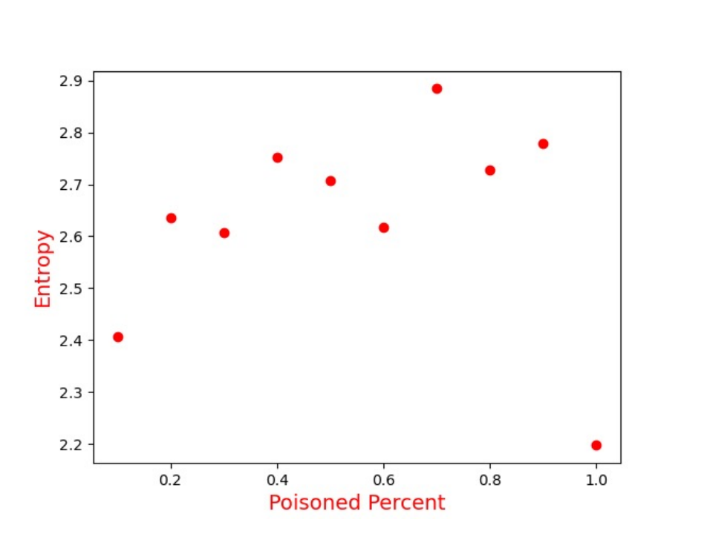
Pre-Design
An experimental evaluation is conducted prior to the introduction of the network structure
Entropy of the poisoning model is higher than benign models
As PSR grows, entropy of the model parameters increases

Slide 9
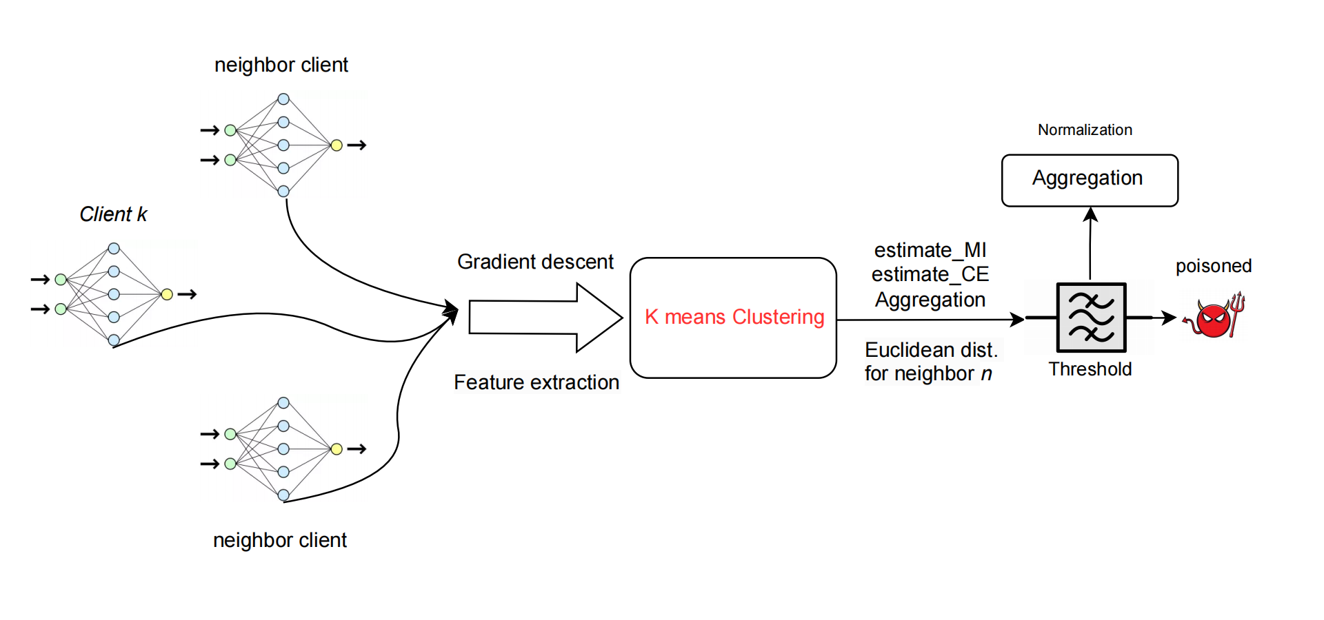
Prototype – AIDFL
Basic ideas:
An anomaly detector filters through a threshold
Maximize mutual information
Minimize conditional entropy
Extension (novel):
Trying to capture more semantic information in DFL settings and non-IID data based on related work

Slide 10
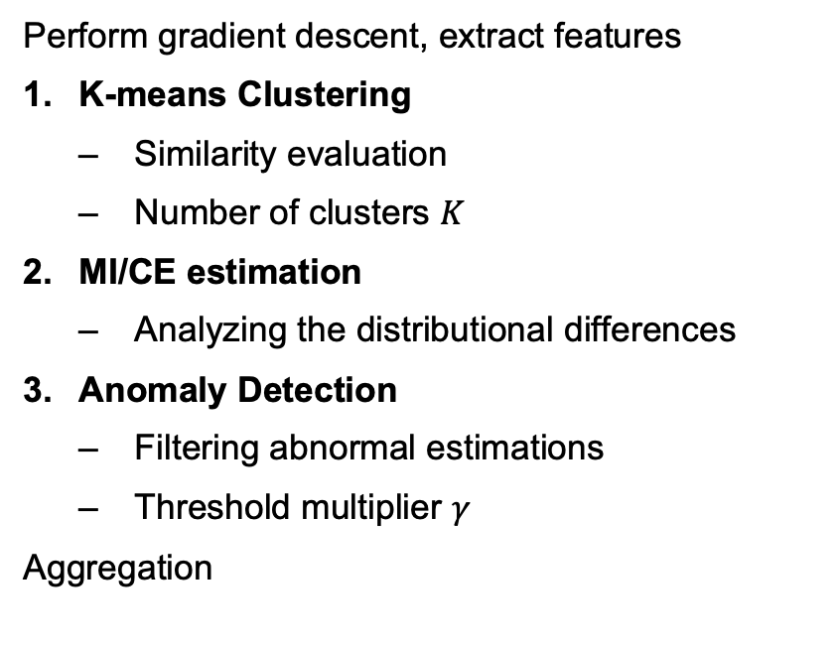
Prototype – AIDFL
Perform gradient descent, extract features
K-means Clustering
Similarity evaluation
Number of clusters $K$
MI/CE estimation
Analyzing the distributional differences
Anomaly Detection
Filtering abnormal estimations
Threshold multiplier $γ$
Aggregation

Slide 11
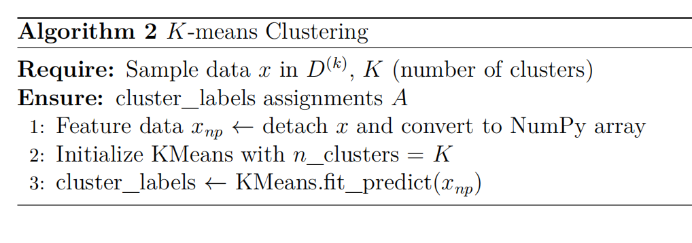
Design – K-means Clustering
Find cluster centers that minimize the variance
Each data point is assigned a cluster label based on the nearest cluster center
Similarity evaluation – identify potential malicious updates

Slide 12
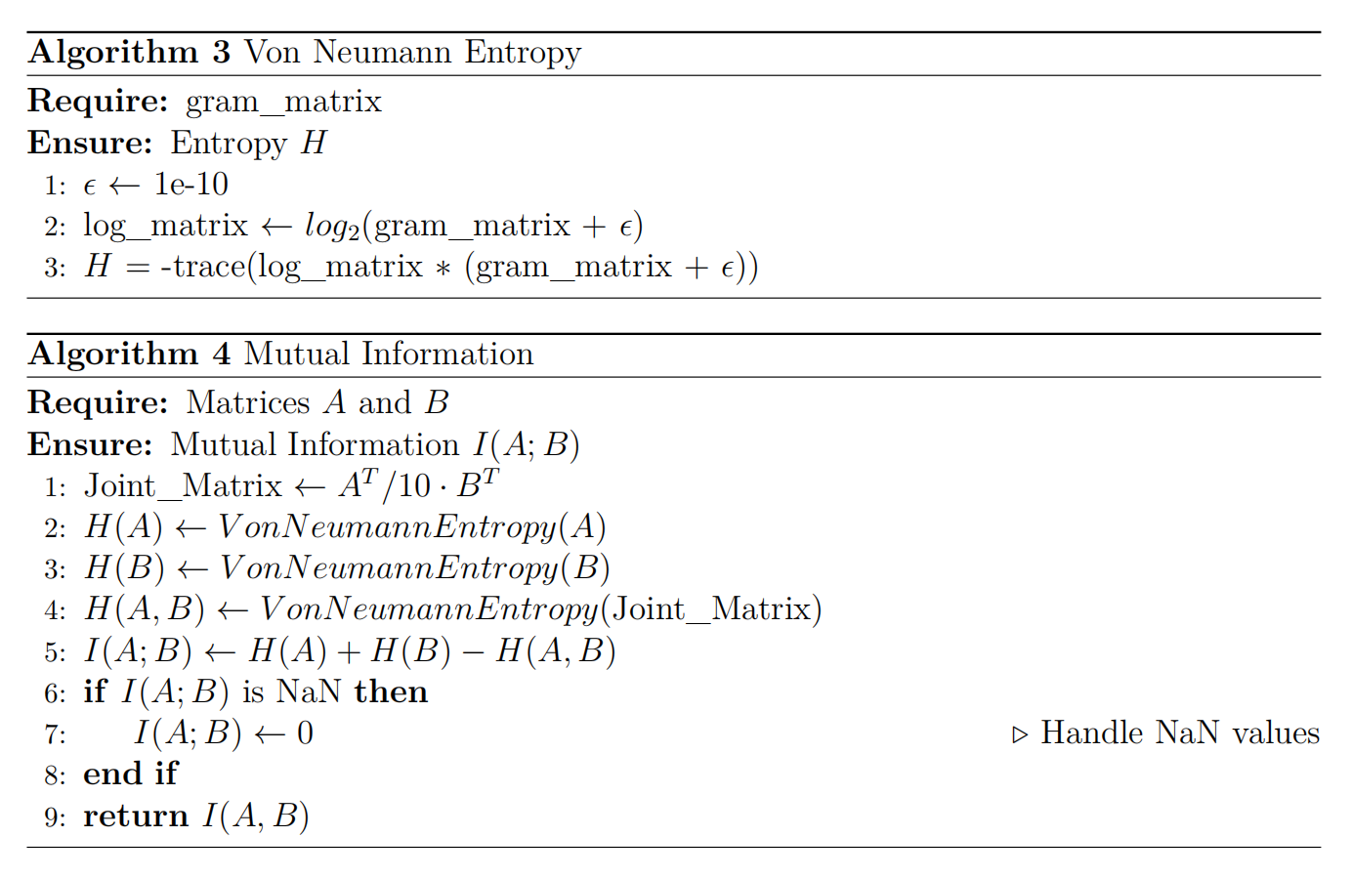
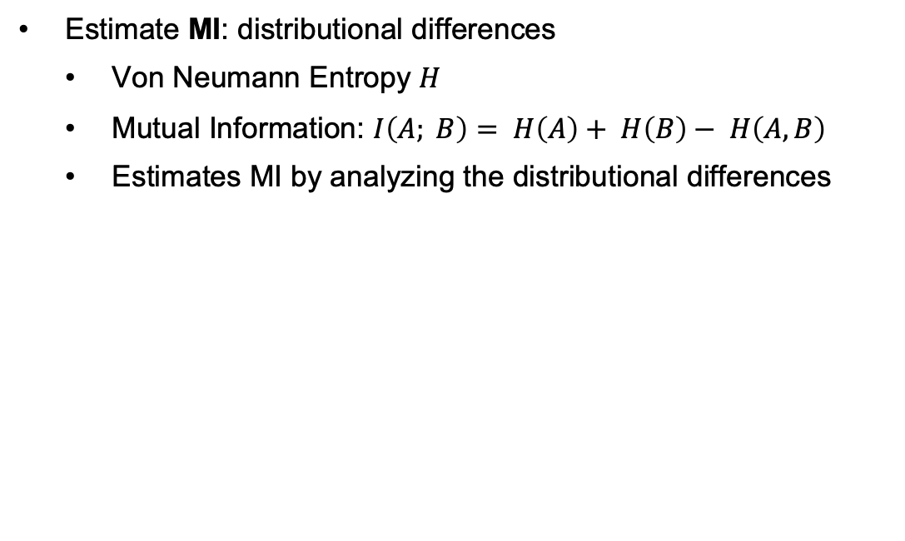
Design – MI/CE Estimations
Estimate MI: distributional differences
Von Neumann Entropy $H$
Mutual Information: $I\left(A; B\right)= H\left(A\right)+ H\left(B\right)− H\left(A, B\right)$
Estimates MI by analyzing the distributional differences

Slide 13
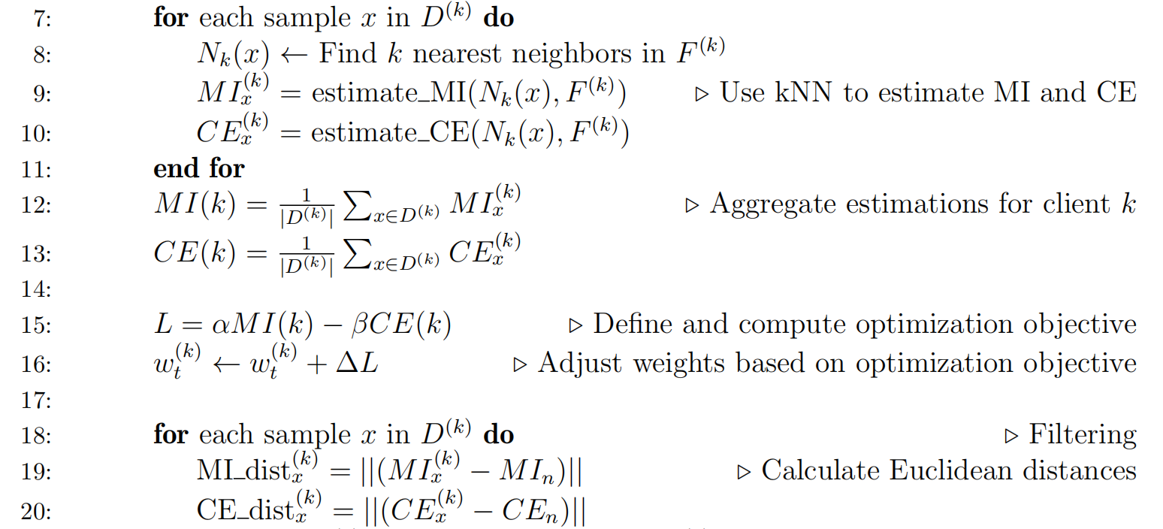
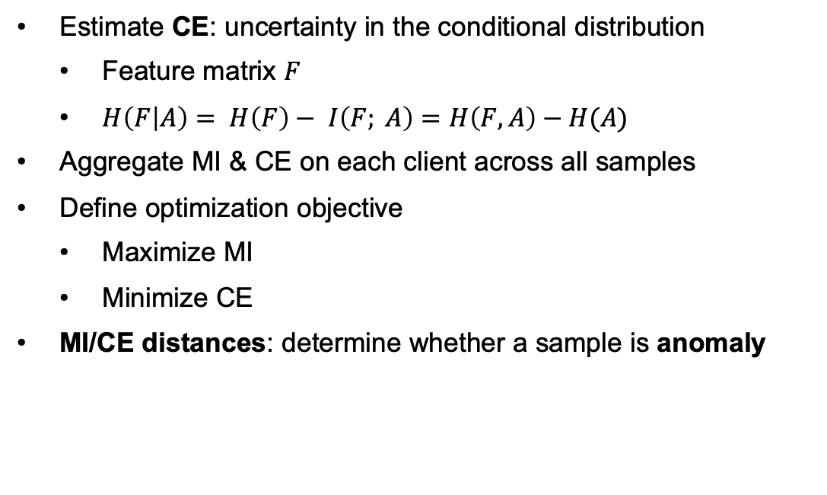
Design – MI/CE Estimations
Estimate CE: uncertainty in the conditional distribution
Feature matrix $F$
$H\left(F | A\right)= H\left(F\right)− I\left(F; A\right)=H\left(F, A\right)−H(A)$
Aggregate MI & CE on each client across all samples
Define optimization objective
Maximize MI
Minimize CE
MI/CE distances: determine whether a sample is anomaly

Slide 14
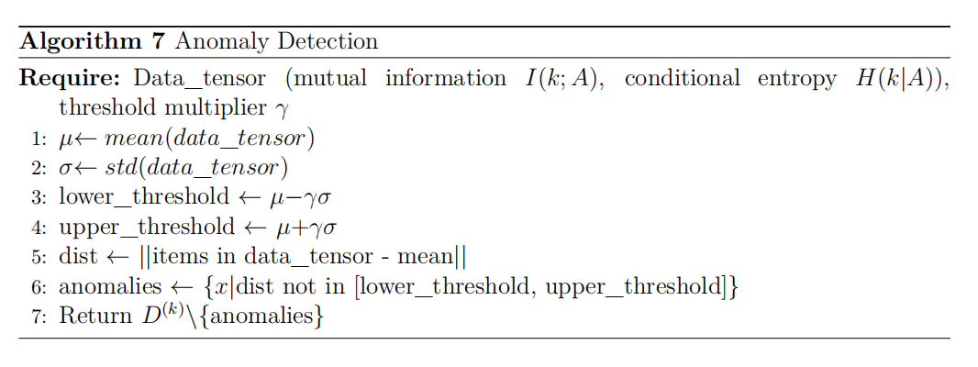
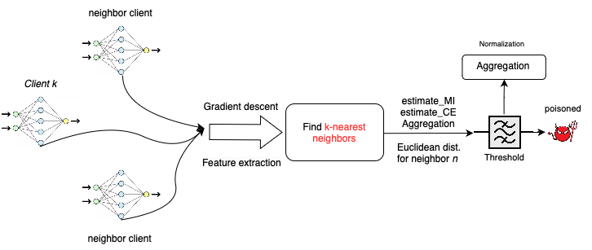
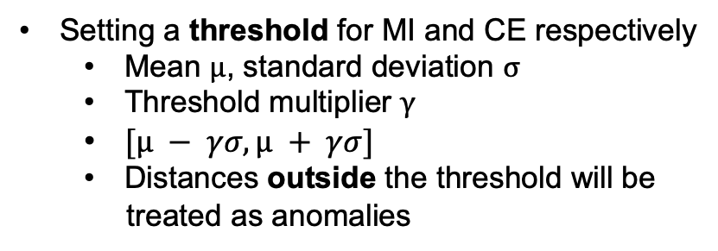
Design – Anomaly Detection
Setting a threshold for MI and CE respectively
Mean $μ$, standard deviation $σ$
Threshold multiplier $γ$
$[µ − γσ, µ + γσ]$
Distances outside the threshold will be
treated as anomalies
Aggregation: non-anomalous
Normalization:
By sum of the weights if > 0
Ensure the aggregated update is properly scaled

Slide 15
Table of Contents
01
Introduction
02
Motivation
03
Design
04
Evaluation
05
Conclusion

Slide 16
Experiment Setup
Network Setting
10 clients for MNIST & FMNIST; 5 clients for CIFAR10
10 rounds
Datasets & Models
MNIST (MLP, epoch = 15)
FMNIST (MLP, epoch = 15)
CIFAR10 (pretrained ResNet18, epoch = 3)
Non-IID data

Slide 17
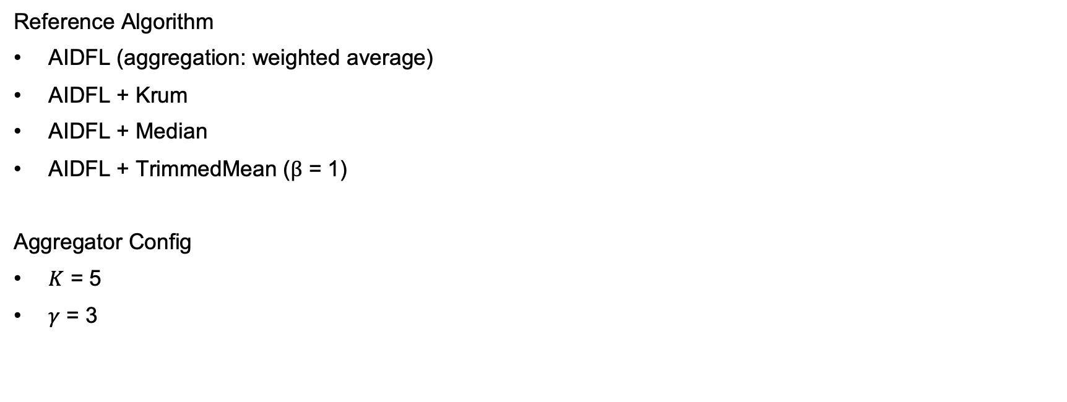
Experiment Setup
Reference Algorithm
AIDFL (aggregation: weighted average)
AIDFL + Krum
AIDFL + Median
AIDFL + TrimmedMean ($β$ = 1)
Aggregator Config
$K$ = 5
$γ$ = 3

Slide 18
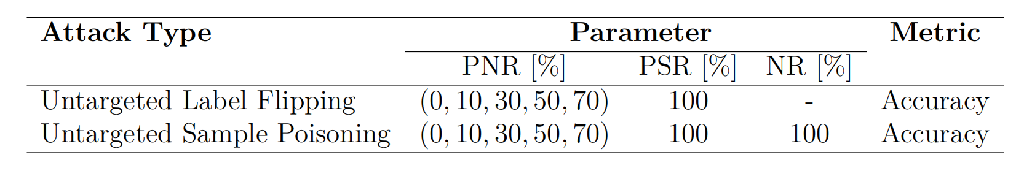
Poisoning Attack Configuration
Attack Types
Untargeted Sample Poisoning – Salt Noise
Untargeted Label Flipping
Parameters
Poisoned Node Ratio (PNR)
MNIST & FMNIST: PNR = 0, 10, 30, 50, 70
CIFAR10: PNR = 0, 20, 60
Poisoned Sample Ratio (PSR)
Noise Ratio (NR)
Metrics
Accuracy

Slide 19
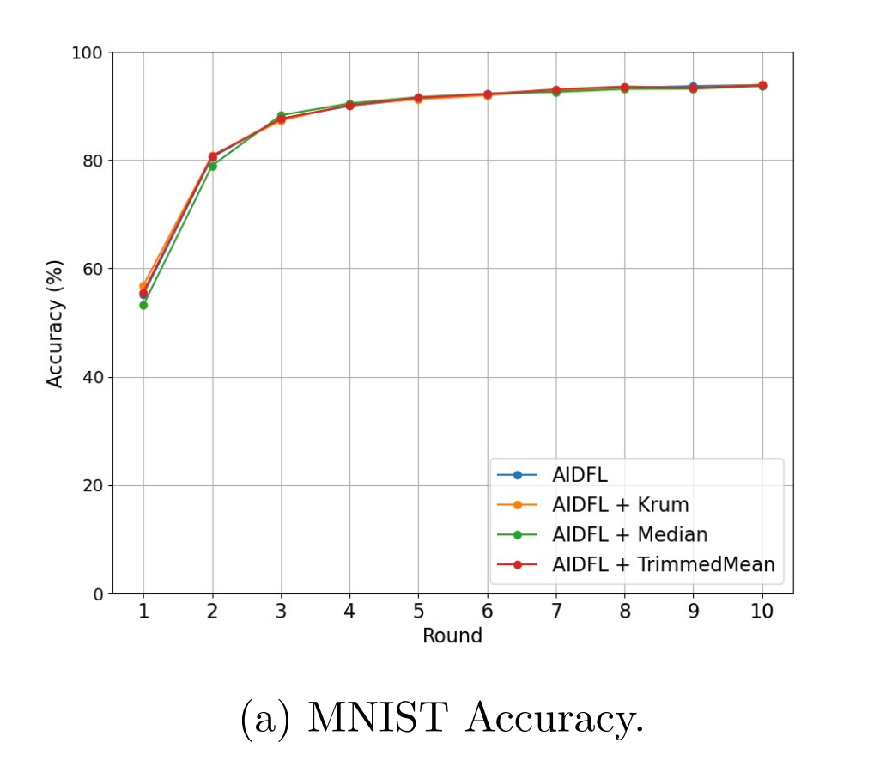
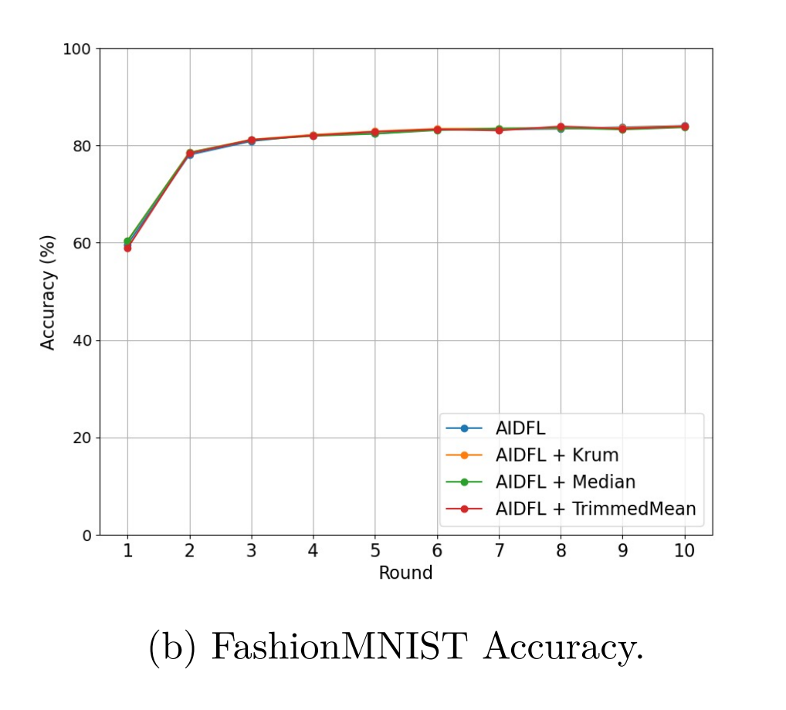
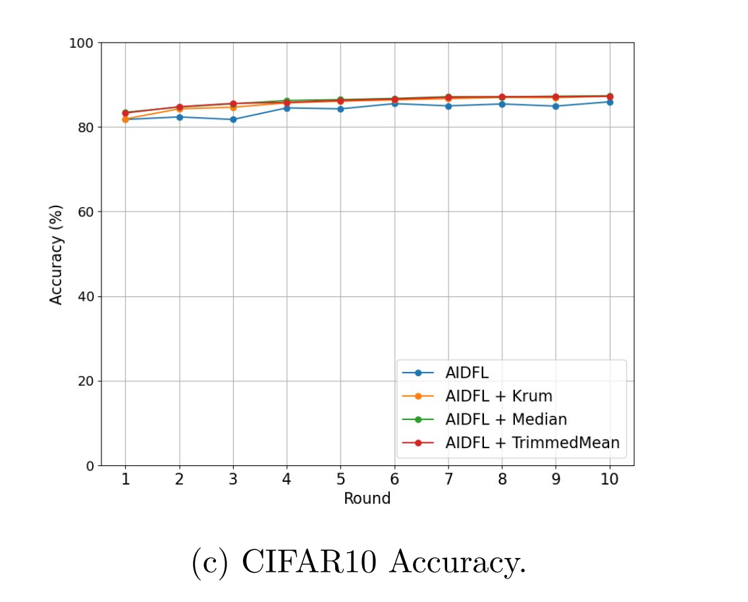
Benign Environment
Performance of each algorithm in a benign environment without poisoned nodes

Slide 20
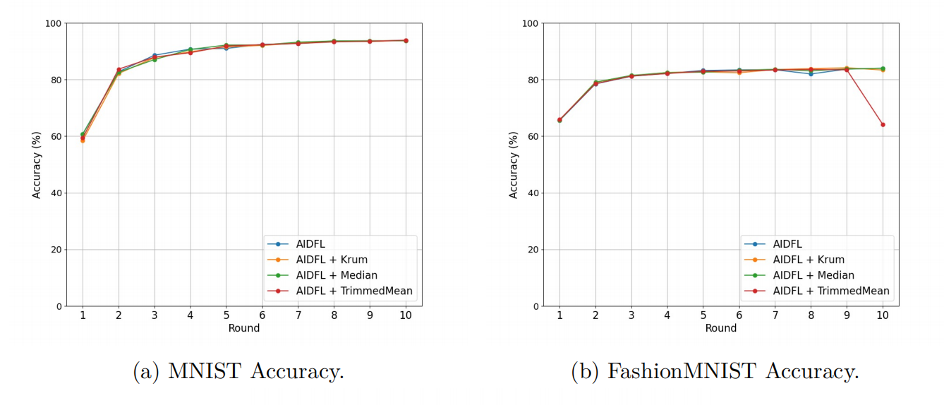
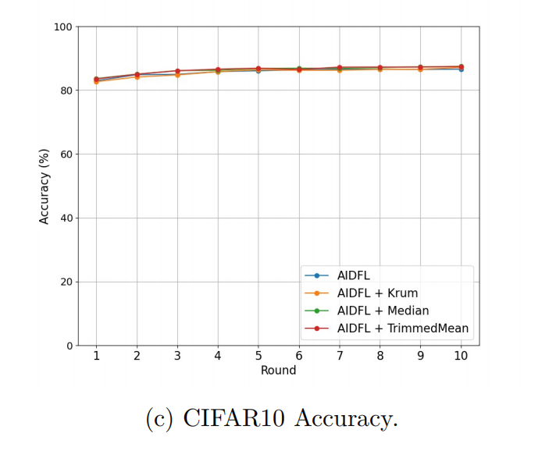
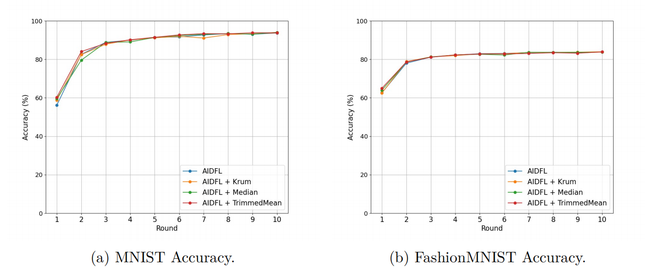
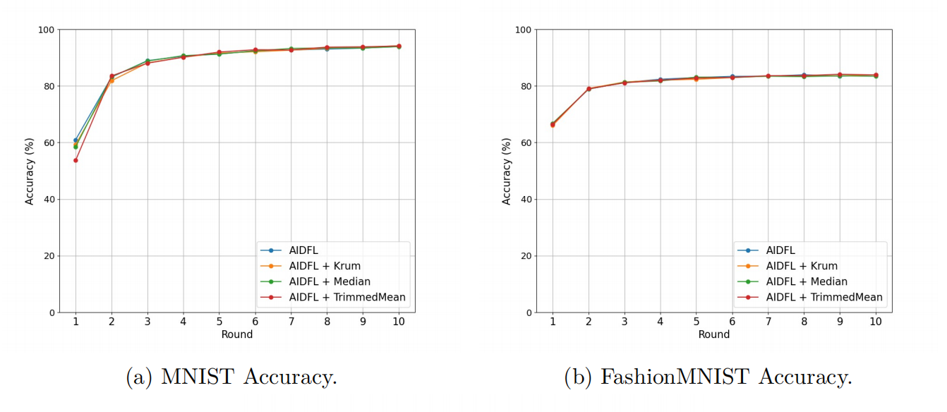
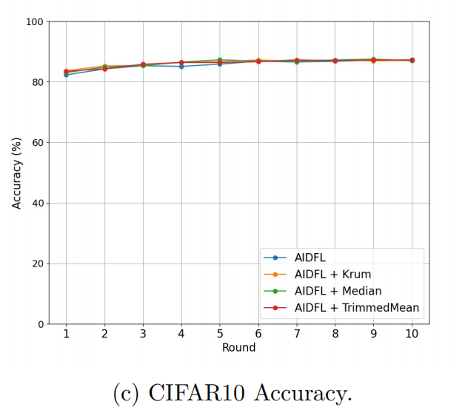
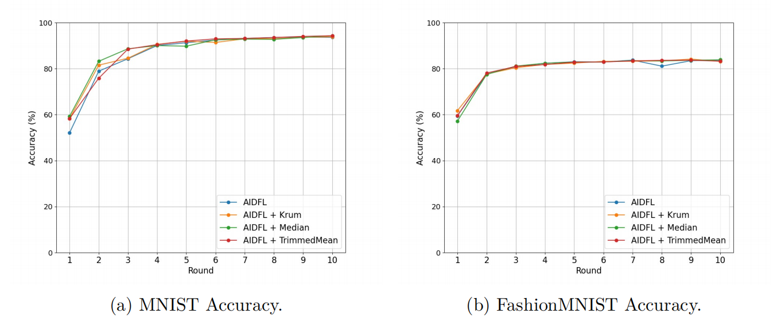
Untargeted Label Flipping
PNR = 10
PNR = 50
PNR = 30
PNR = 70

Slide 21
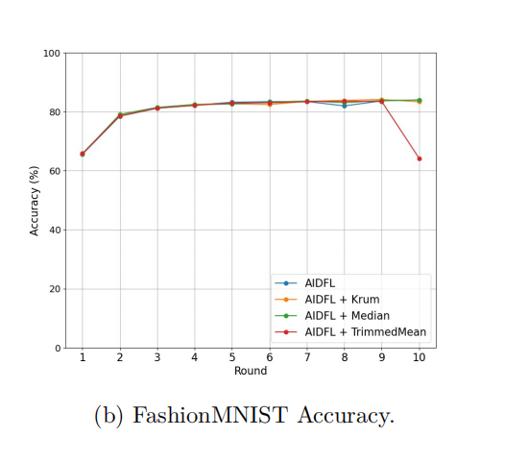
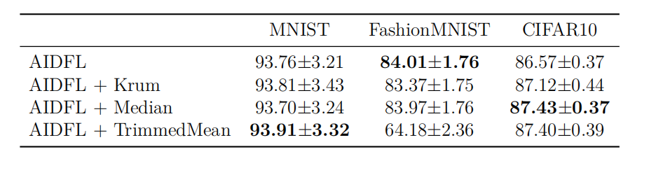
Untargeted Label Flipping
PNR = 10

Slide 22
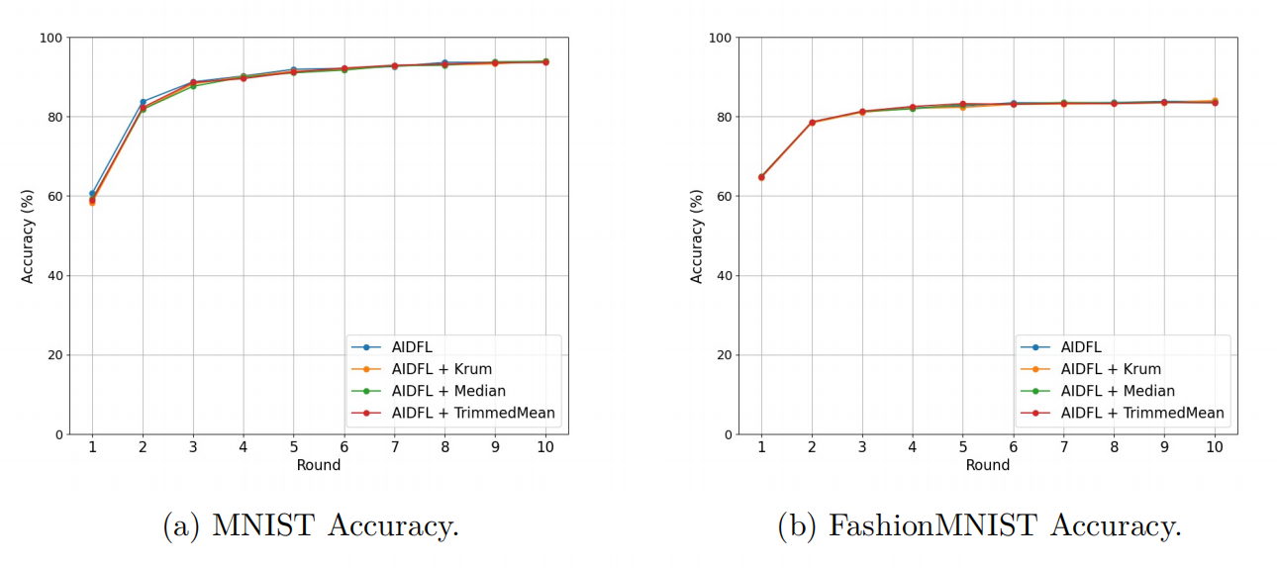
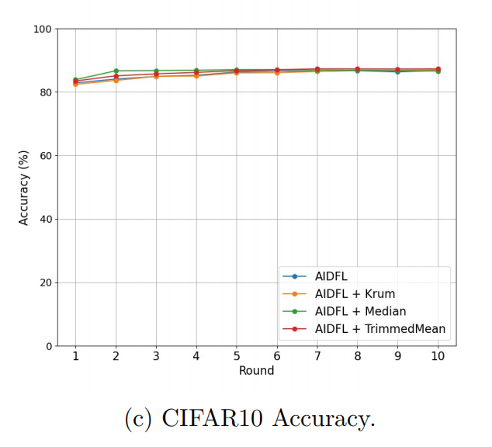
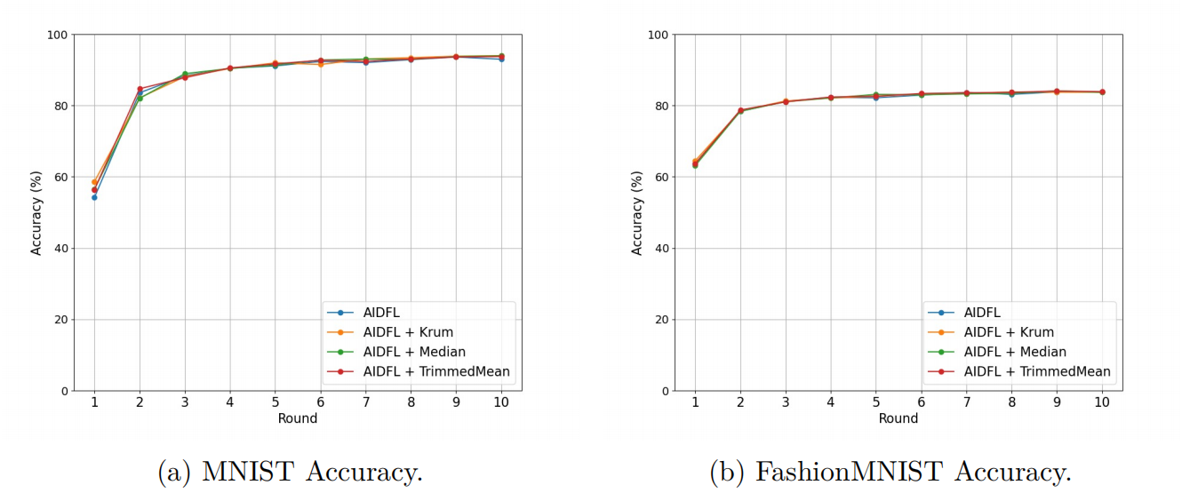
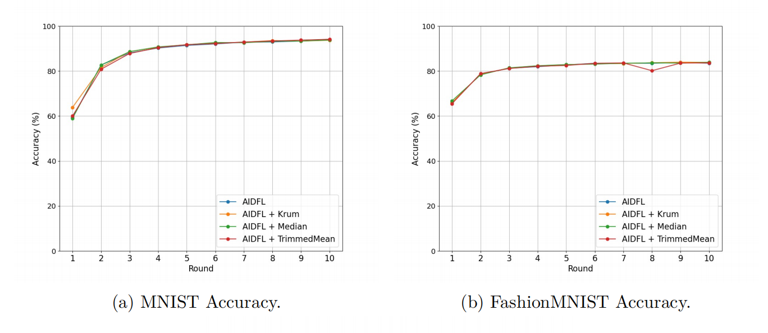
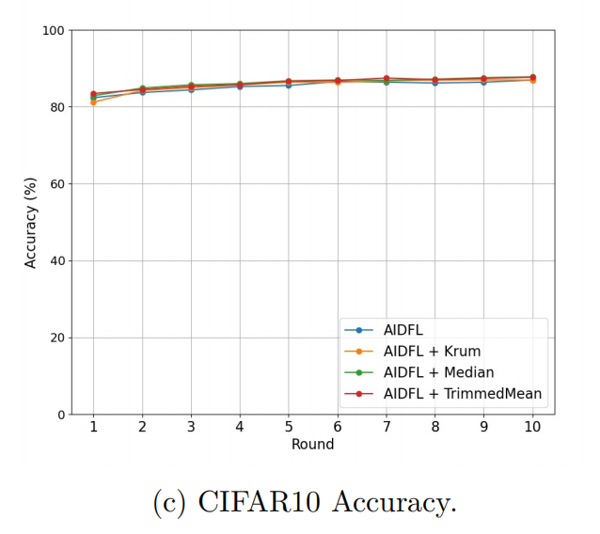
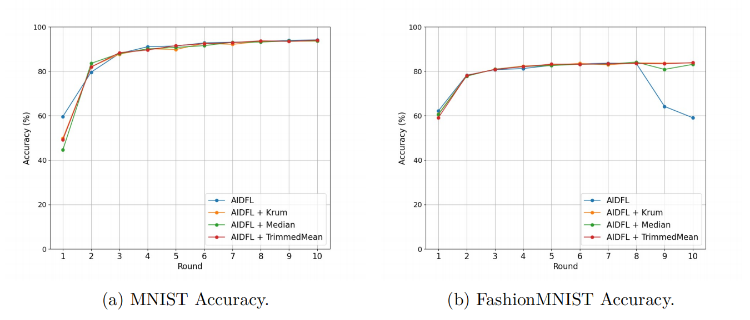
Untargeted Sample Poisoning
PNR = 10
PNR = 50
PNR = 30
PNR = 70

Slide 23
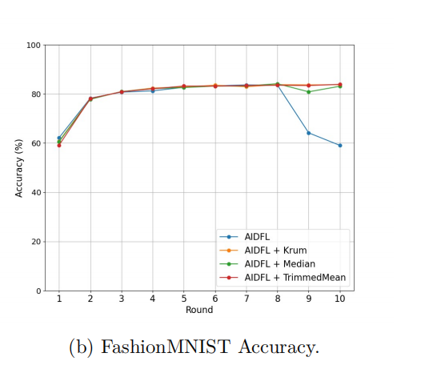
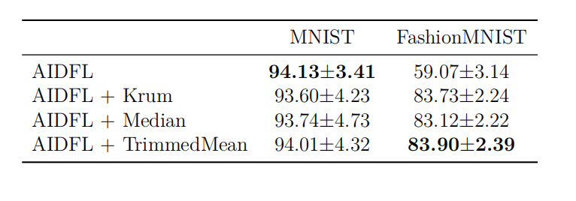
Untargeted Sample Poisoning
PNR = 70

Slide 24
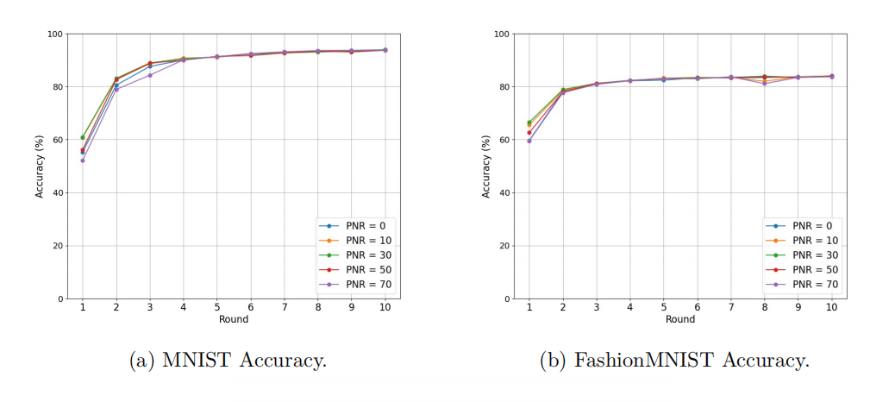
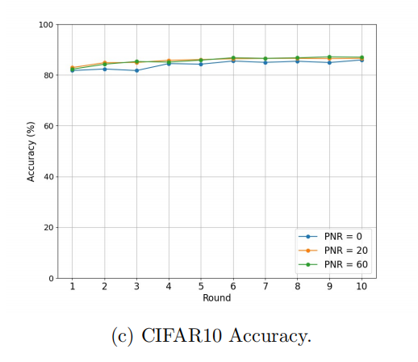
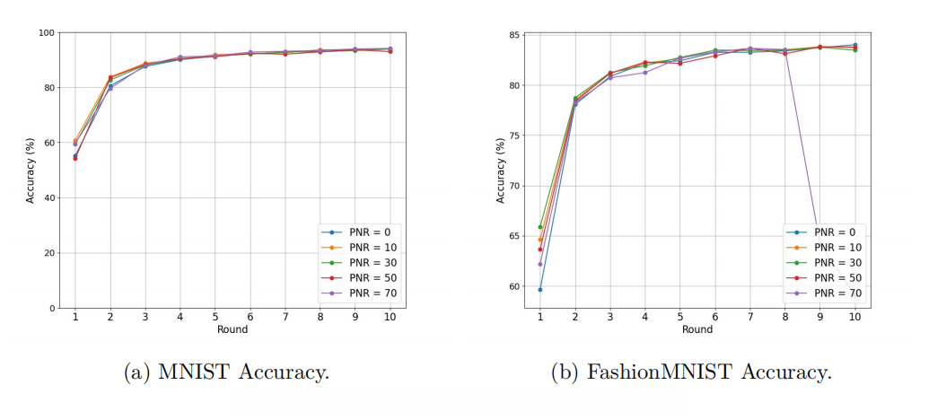
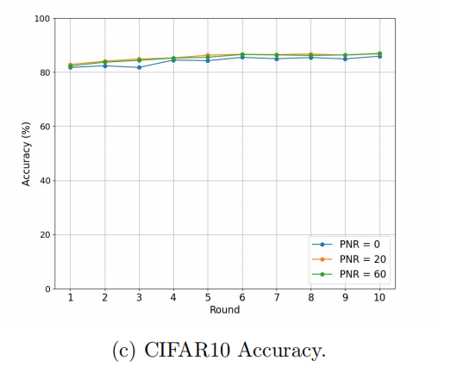
AIDFL: Different PNR
Untargeted Label Flipping
Untargeted Data Poisoning

Slide 25
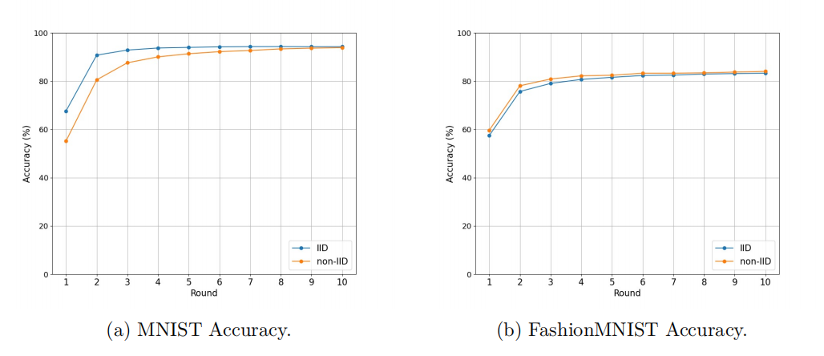
AIDFL: IID vs. non-IID
Benign models

Slide 26
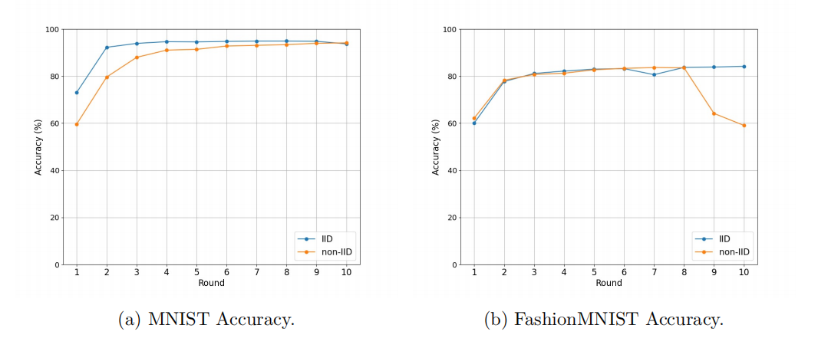
AIDFL: IID vs. non-IID
Recall…
Untargeted sample poisoning, PNR = 70
AIDFL performs well in label flipping attacks
Untargeted sample poisoning, PNR = 70
Uneven data distribution interfere defense effect
IID vs. non-IID
Comparing different algorithms

Slide 27
Table of Contents
01
Introduction
02
Motivation
03
Design
04
Evaluation
05
Conclusion

Slide 28
Conclusion
AIDFL performs well on defending against untargeted data poisoning attacks
Exception: highly poisoned sample poisoning environment

Slide 29
Limitations
Compare AIDFL as an anomaly detector to other aggregation approaches
Lack of analyze resource consumption
Improvements:
include a comparison between AIDFL as a whole and other algorithms

Slide 30
Future Work
Model poisoning attacks and targeted data poisoning attacks
Directly comparing with other aggregation protocols as a comprehensive hybrid defense mechanism
Increasing to 10 clients on CIFAR10
Running on user-friendly platform like Fedstellar

Slide 31
Thank you!

